Slide 1
Technical Session I Basics of Python
Dr. Ambika P
Expert Data Scientist
Impact Analytics, Bangalore
9590399036
ambika2202@gmail.com
linkedin.com/in/drambika

Slide 2
Introduction
Python is a high-level, interpreted, interactive and object-oriented scripting language.
Python was developed by Guido van Rossum in the late eighties and early nineties .

Slide 3
Local Environment Setup
Python is available on a wide variety of platforms including Windows, Linux and Mac OS X.
Open a terminal window and type "python" to find out if it is already installed and which version is installed.

Slide 4
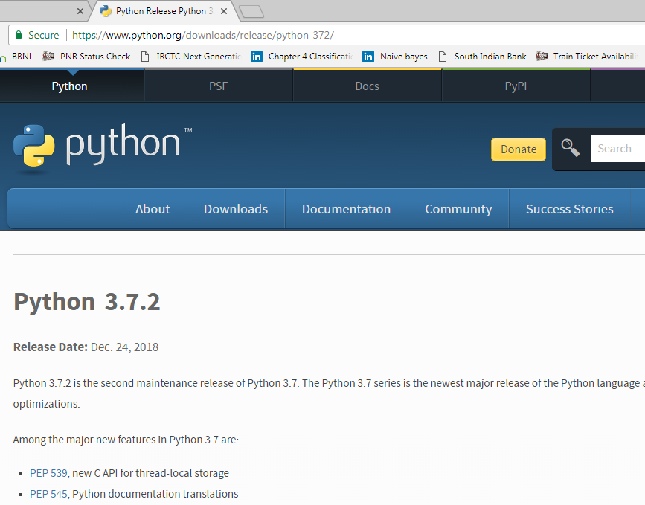

Slide 5
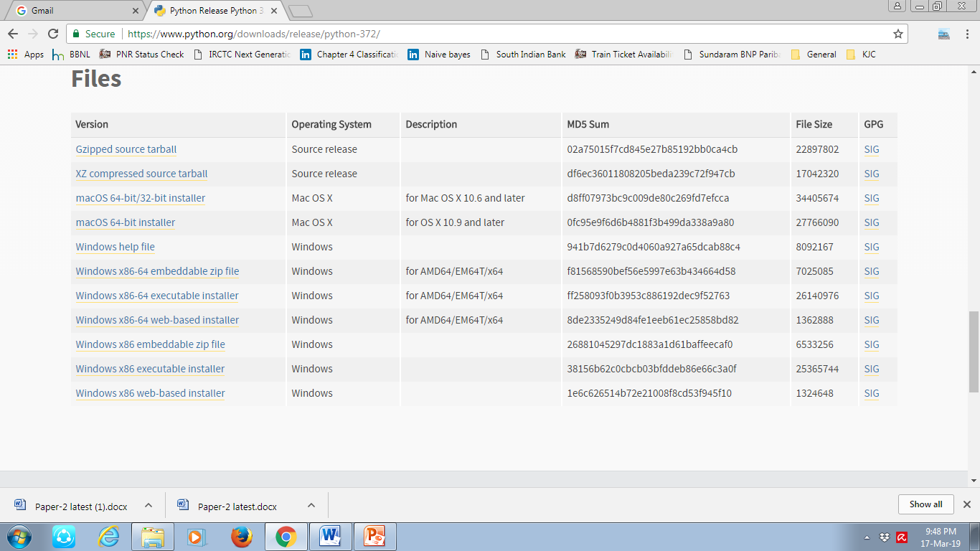

Slide 6
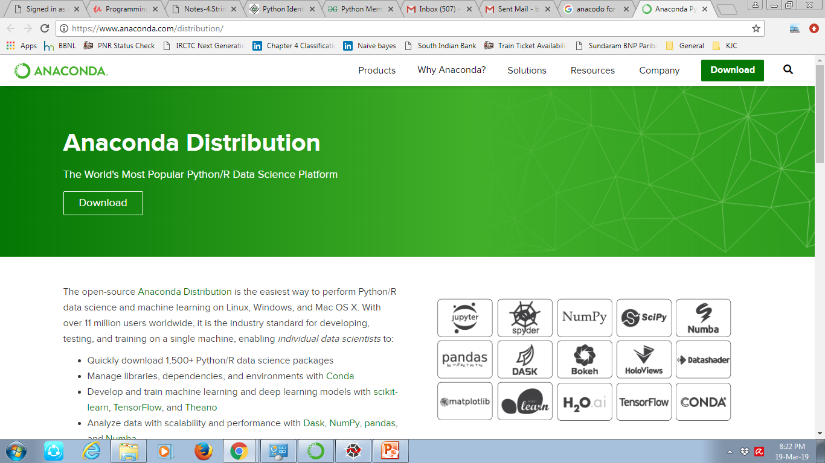
Anaconda

Slide 7
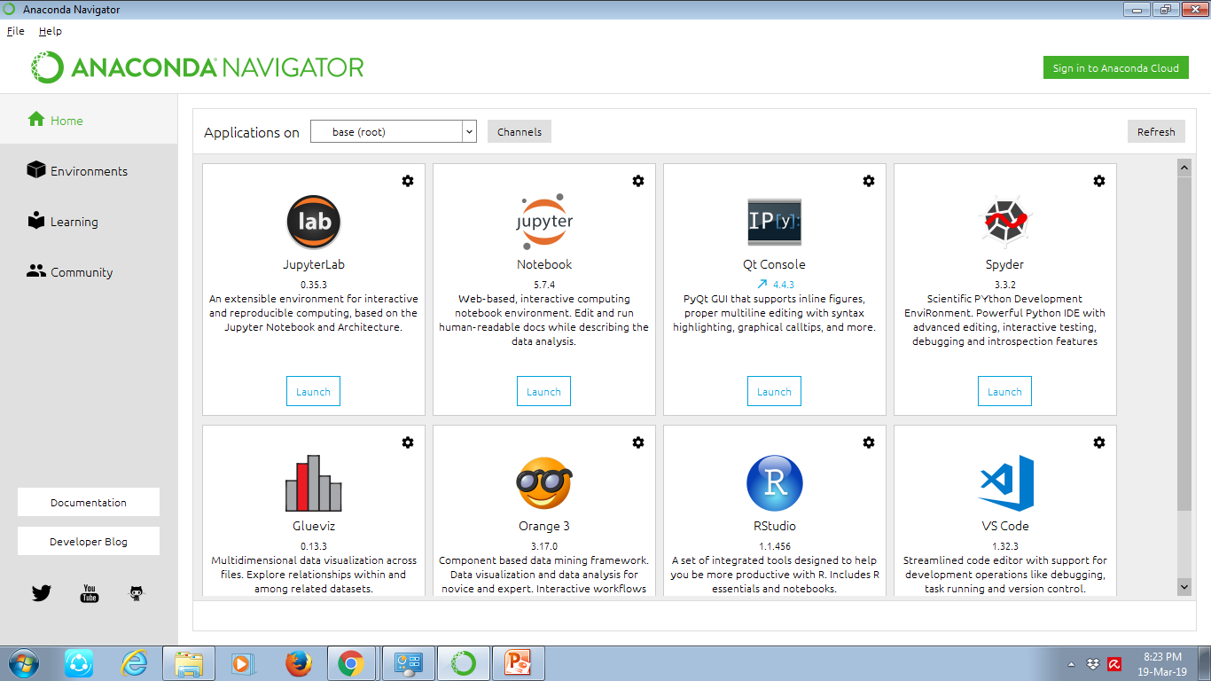
Anaconda Navigator

Slide 8
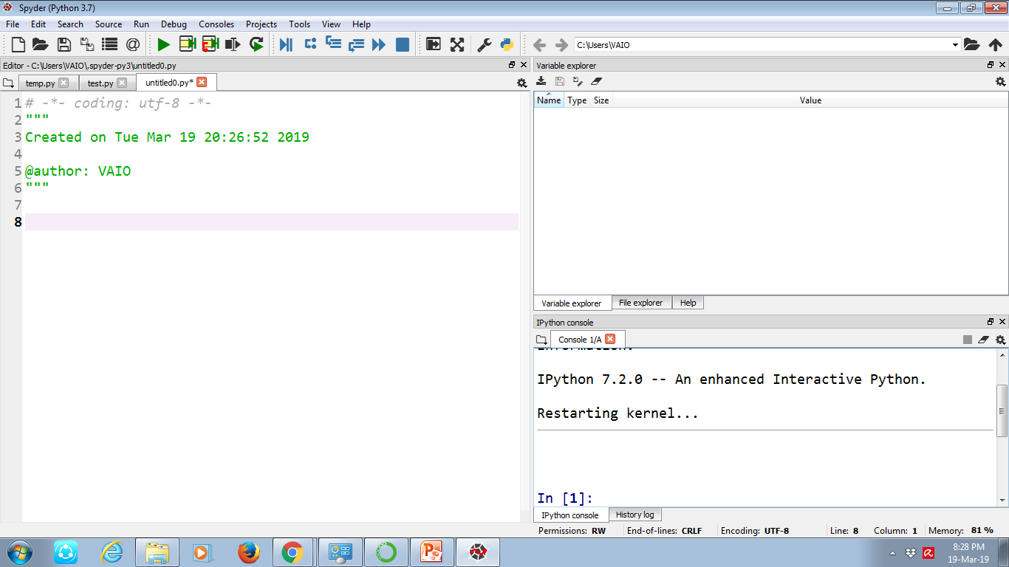
SPYDER

Slide 9
Assigning Values to Variables
Python variables do not need explicit declaration to reserve memory space.
The declaration happens automatically when you assign a value to a variable.
The equal sign (=) is used to assign values to variables.

Slide 10
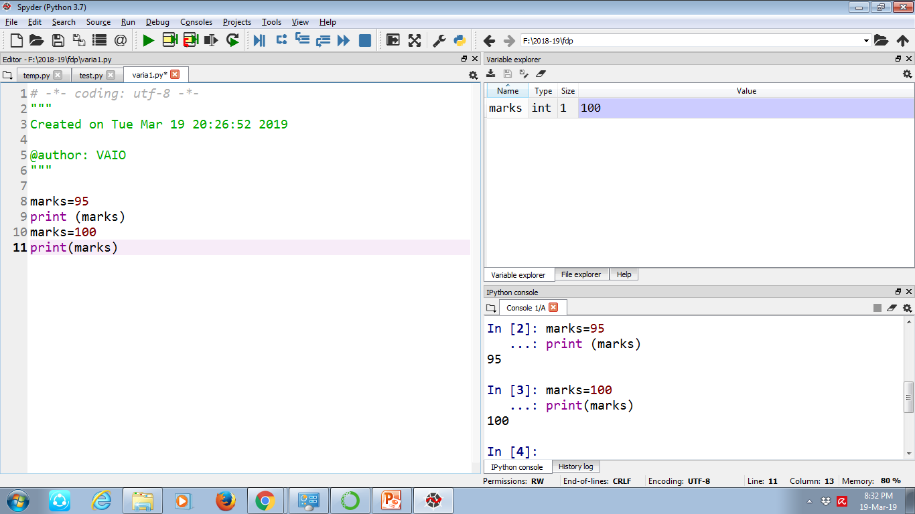
SPYDER

Slide 11
Python - Basic Operators
Operators are the constructs which can manipulate the value of operands.
python language supports the following types of operators.
Arithmetic Operators
Comparison (Relational) Operators
Assignment Operators
Logical Operators
Bitwise Operators
Membership Operators
Identity Operators

Slide 12
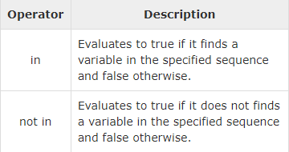
Membership operators
Python’s membership operators test for membership in a sequence, such as strings, lists, or tuples.

Slide 13
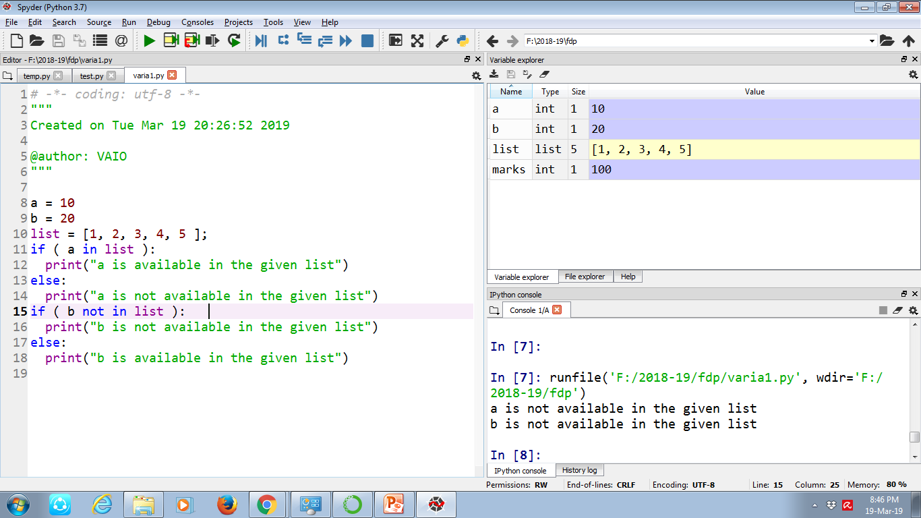

Slide 14
Identity operators
It used to determine whether a value is of a certain class or type.
They are usually used to determine the type of data a certain variable contains.
1. ‘is’ operator – Evaluates to true if the variables on either side of the operator point to the same object
a = 20
b = 20
if ( a is b ):
print ("a and b have same identity")
else:
print ("a and b do not have same identity")

Slide 15
is not’ operator – Evaluates to false if the variables on either side of the operator point to the same object and true otherwise.
if ( a is not b ):
print "a and b do not have same identity"
else:
print "a and b have same identity"

Slide 16
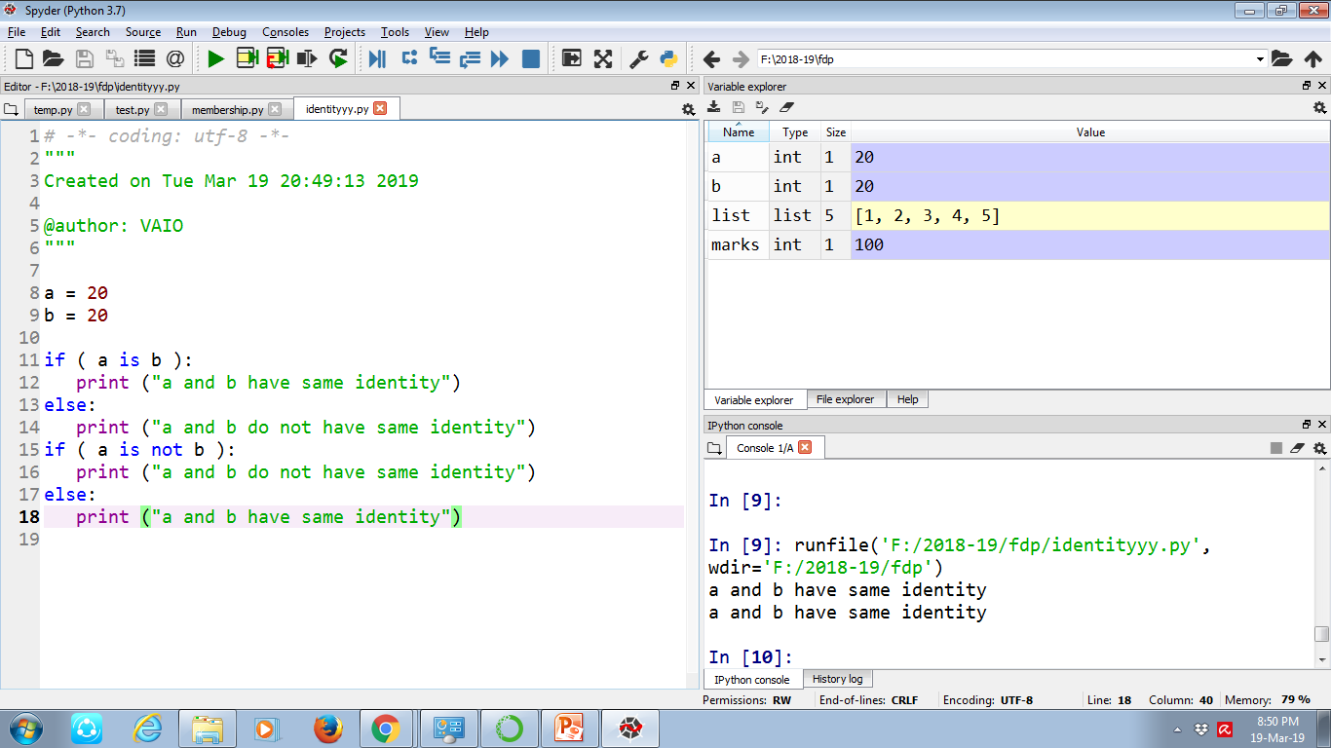

Slide 17
Data Types
Python has various standard data types that are used to define the operations on them.
Python has five standard data types −
Numbers
String
List
Tuple
Dictionary

Slide 18
Numbers
Number data types store numeric values. Number objects are created when you assign a value to them.
For example −
var1 = 1 var2 = 10
You can also delete the reference to a number object by using the del statement.
Del var1

Slide 19
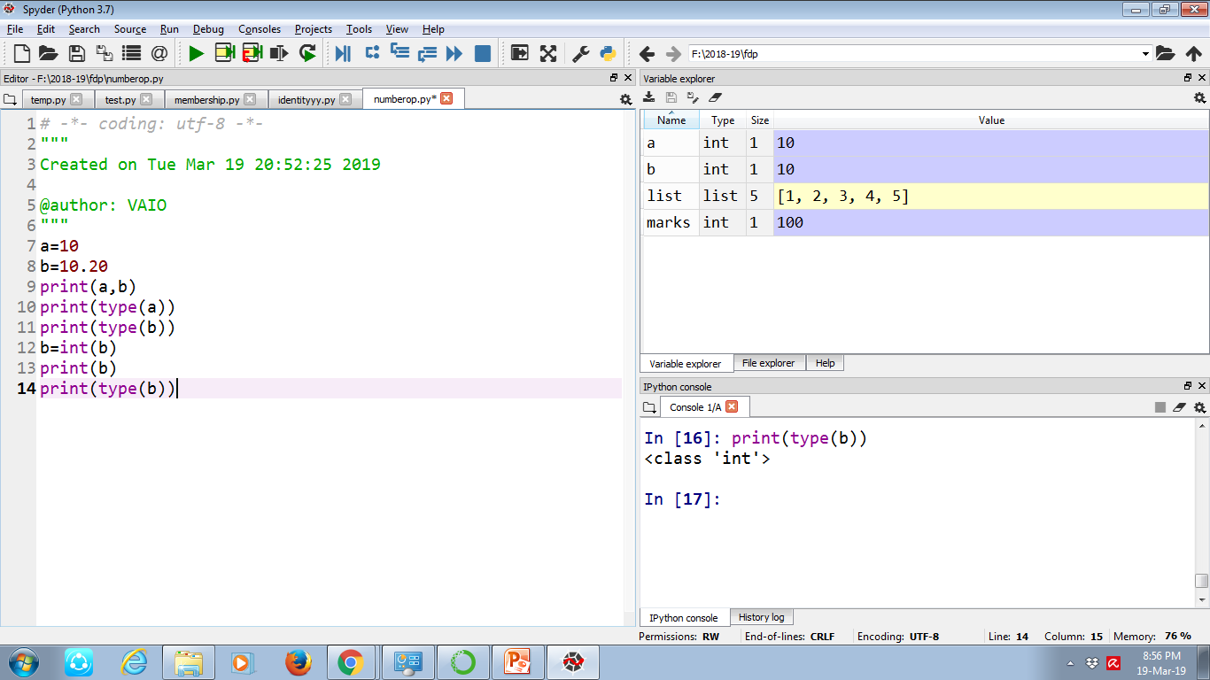
Example

Slide 20
Strings
Strings are amongst the most popular types in Python. We can create them simply by enclosing characters in quotes. Python treats single quotes the same as double quotes.

Slide 21
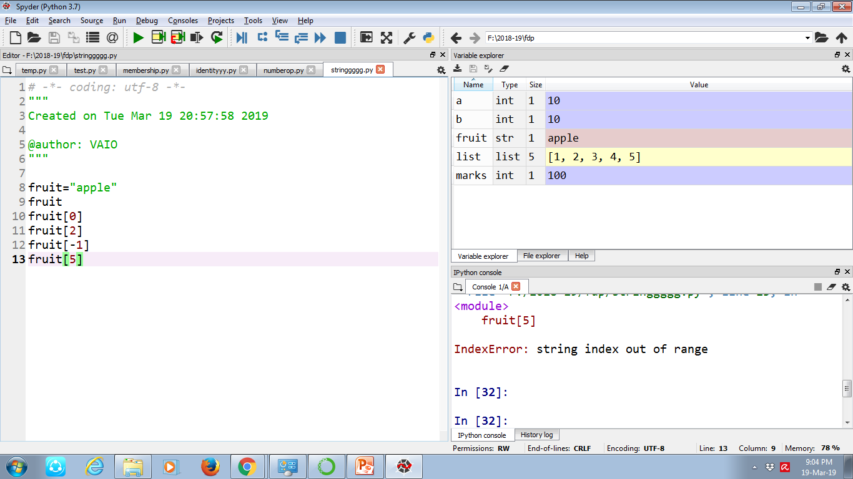
Example

Slide 22
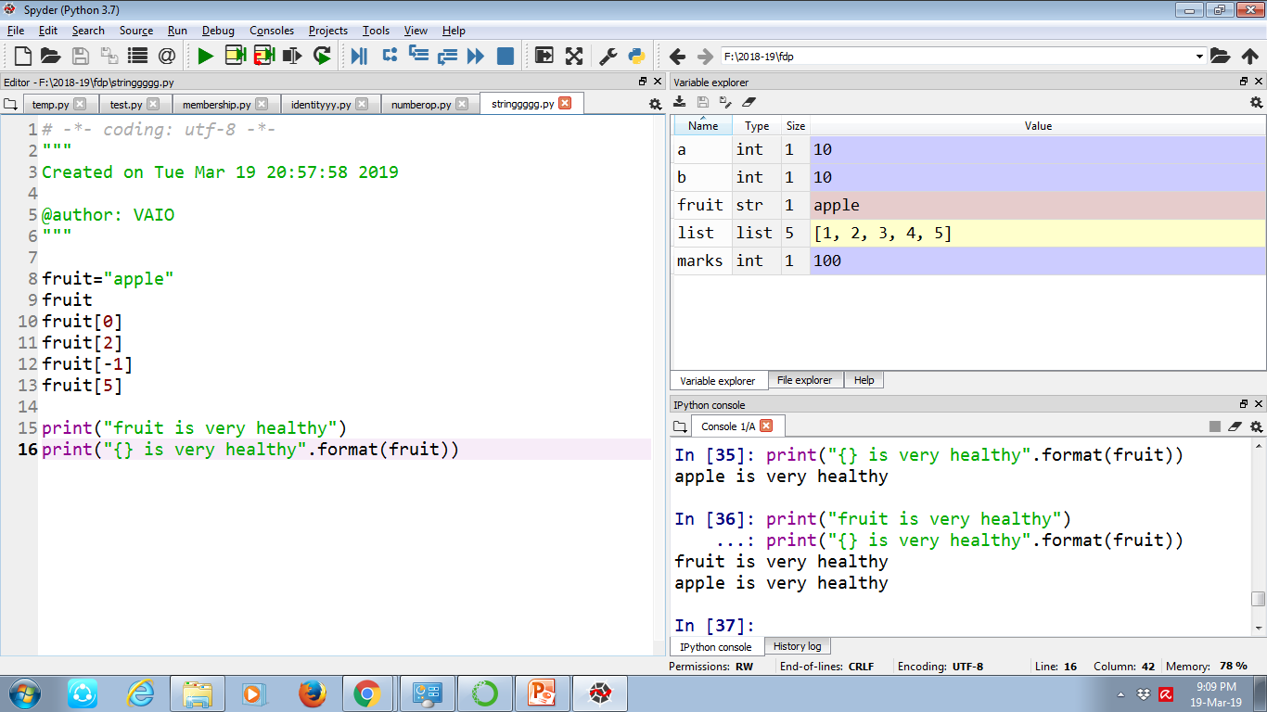

Slide 23
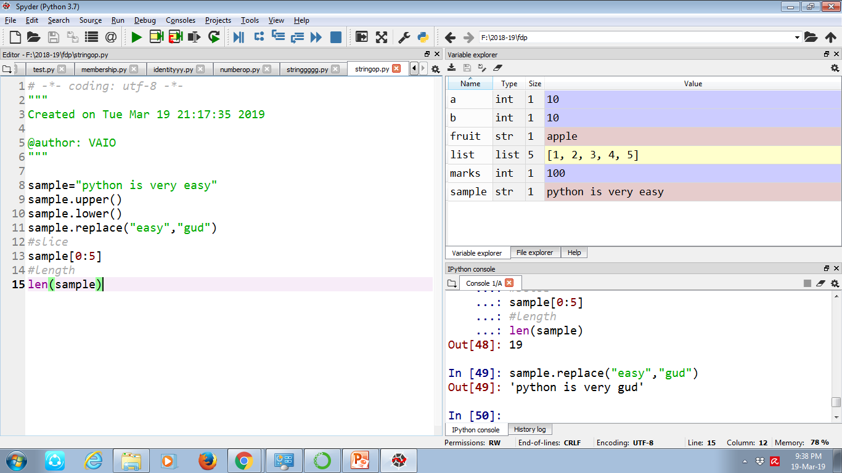
String operations

Slide 24
Lists
The list is a most versatile datatype available in Python which can be written as a list of comma-separated values (items) between square brackets.
Important thing about a list is that items in a list need not be of the same type.

Slide 25
list1 = [‘bca', ‘bsc', 1999];
list2 = [1, 2, 3, 4, 5 ];
list3 = ["a", "b", "c", "d"]

Slide 26
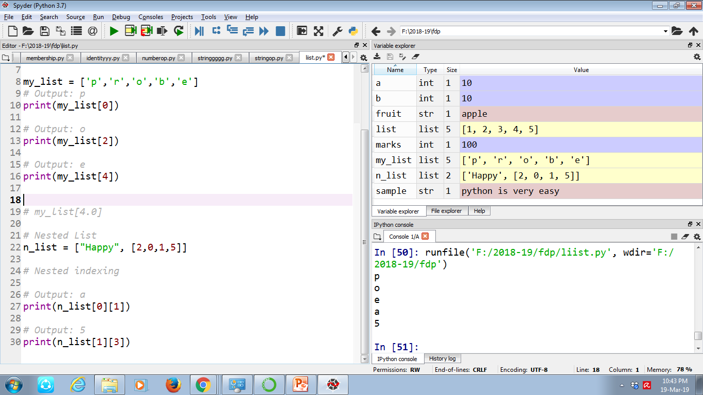

Slide 27
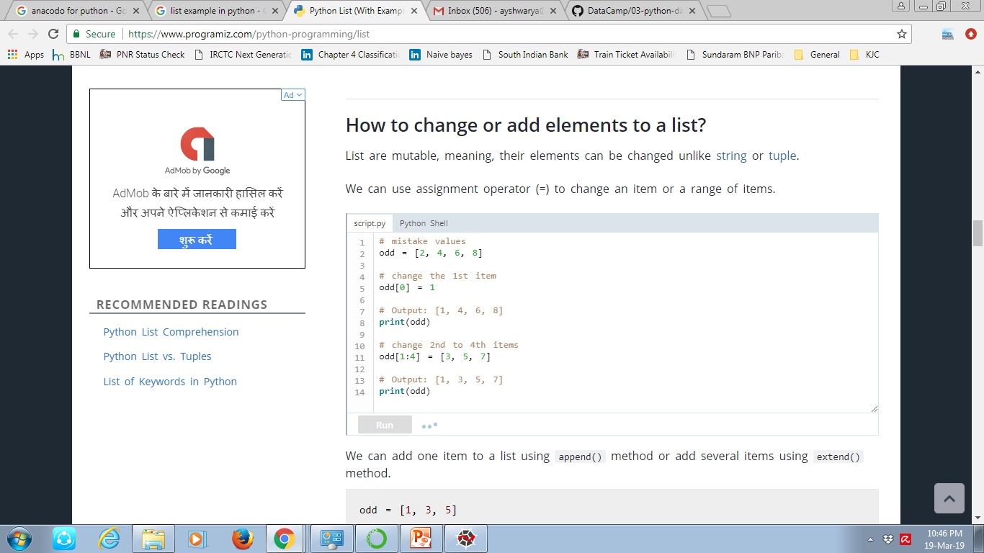
Accessing Values in Lists
List are mutable, meaning, their elements can be changed unlike string or tuple.

Slide 28
List functions
Append-The method append() appends a passed obj into the existing .
Insert- The method insert() inserts object obj into list at offset index.
Remove-This method does not return any value but removes the given object from the list.
Reverse-The method reverse() reverses objects of list in place.

Slide 29
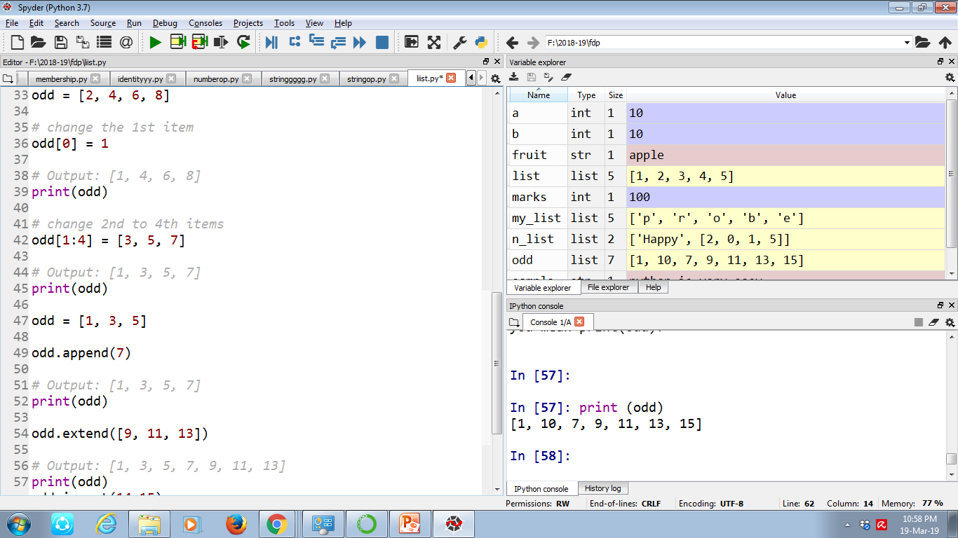

Slide 30
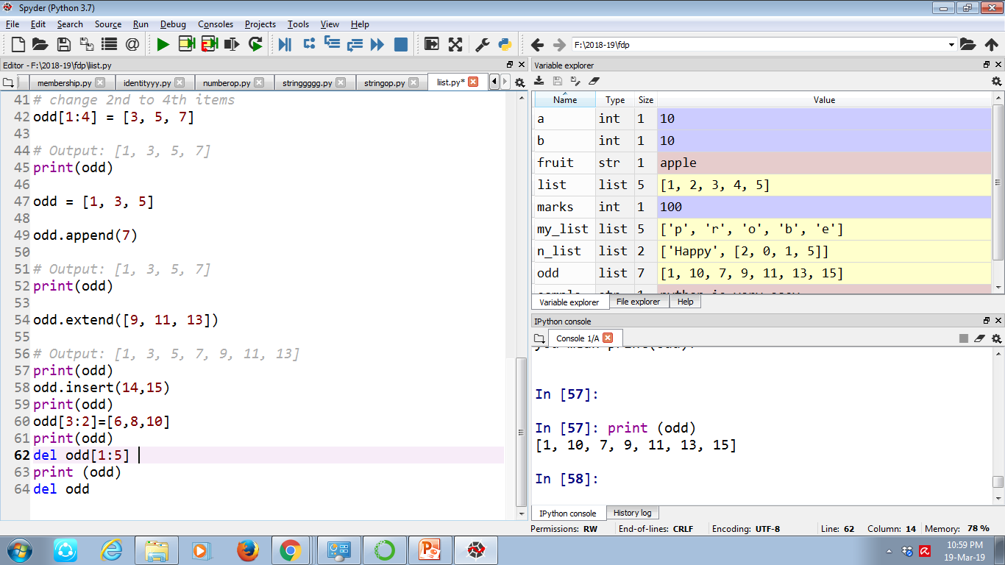

Slide 31
Tuples
A tuple is a sequence of immutable Python objects.
Tuples are sequences, just like lists.
The differences between tuples and lists are, the tuples cannot be changed unlike lists .
Eg1: tup = ('bca', 'bsc', 1999, 2000);
print (tup);

Slide 32
Dictionary
A Python dictionary is a mapping of unique keys to values. Dictionaries are mutable, which means they can be changed.
dict = {'Name': 'Zara', 'Age': 7, 'Class': 'First'}
Print( "dict['Name']: ", dict['Name'])
print ("dict['Age']: ", dict['Age'])

Slide 33
dict = {'Name': 'Zara', 'Age': 7, 'Class': 'First'} del dict['Name']; # remove entry with key 'Name' dict.clear(); # remove all entries in dict del dict ; # delete entire dictionary

Slide 34
Dictionary
Python dictionary is an unordered collection of items.
While other compound data types have only value as an element, a dictionary has a key: value pair.

Slide 35
my_dict = {'name':'Jack', 'age': 26}
# Output: Jack
print(my_dict['name'])
# Output: 26
print(my_dict.get('age'))

Slide 36
Dictionary Functions
Len-The method len() gives the total length of the dictionary.
dict = {'Name': 'Zara', 'Age': 7};
print (len(dict))
Copy-The method copy() returns a shallow copy of the dictionary.
dict1 = {'Name': 'Zara', 'Age': 7};
dict2 = dict1.copy()
print "New Dictionary : %s" % str(dict2)

Slide 37
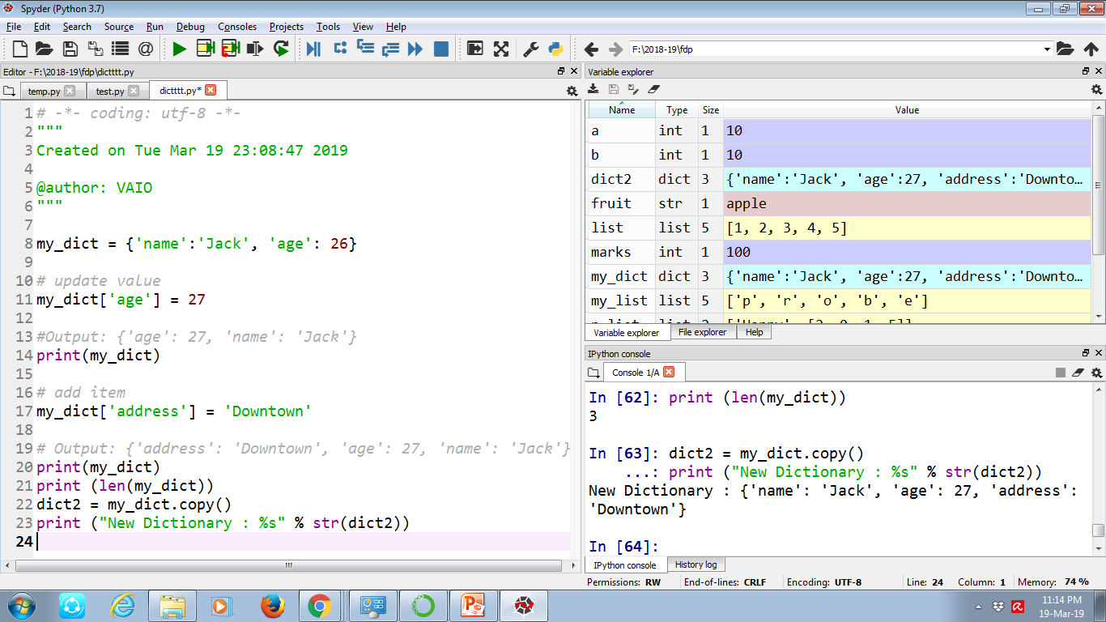

Slide 38
Keys-The method keys() returns a list of all the available keys in the dictionary.
my_dict = {'name':'Jack', 'age': 26}
print "Value : %s" % dict.keys()
Values-The method values() returns a list of all the values available in a given dictionary.
print "Value : %s" % dict.values()

Slide 39
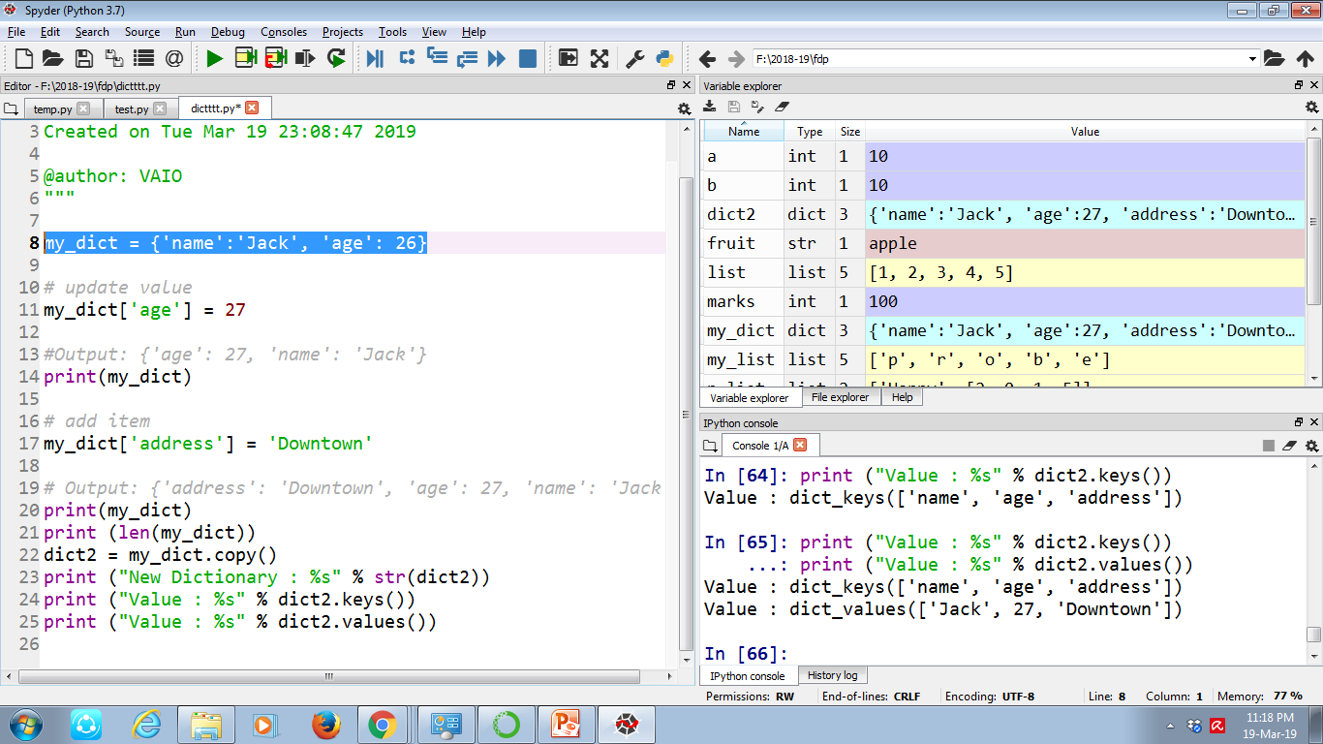

Slide 40
Set in Python
A set is an unordered collection of items.
Every element is unique (no duplicates) and must be immutable (which cannot be changed).
my_set = {1, 2, 3}
print(my_set)

Slide 41
Change a set in Python
Sets are mutable. But since they are unordered, indexing have no meaning.
We can add single element using the add() method and multiple elements using the update() method.
The update() method can take tuples, lists, strings or other sets as its argument. In all cases, duplicates are avoided.

Slide 42
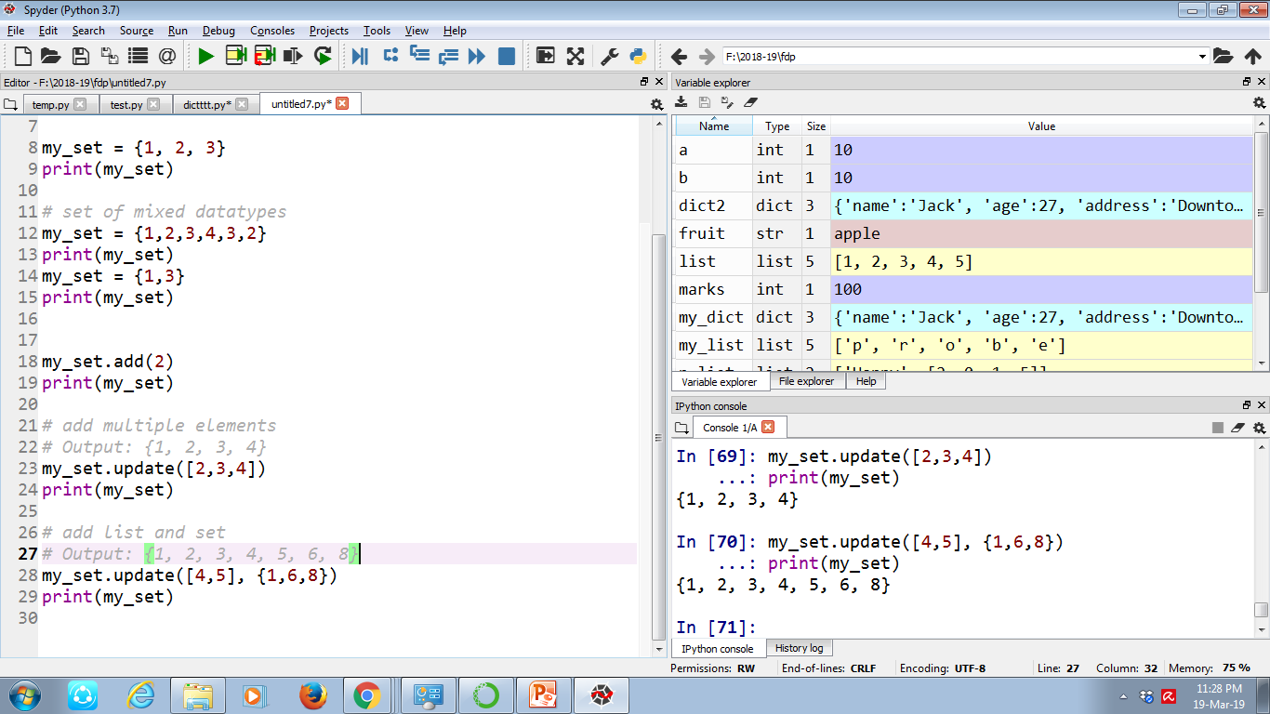

Slide 43
Remove elements from a set
A particular item can be removed from set using methods, discard() and remove().
The only difference between the two is that, while using discard() if the item does not exist in the set, it remains unchanged.
But remove() will raise an error in such condition.
my_set.discard(4)
print(my_set)
my_set.remove(4)

Slide 44
Modules and Packages

Slide 45
Modules and packages
Facilitate modular programming
To manage multiple subtasks
Smaller Python scripts can be a module. But larger programs are split into several modules.
Modules are grouped together to form packages.
The main difference between a module and a package is that a package is a collection of modules AND it has an __init__.py file.

Slide 46
Modules can be identified
Modules are searched for in the following places:
the current working directory (for interactive sessions)
the directory of the top-level script ﬁle (for script ﬁles)
the directories deﬁned in PYTHONPATH
Standard library directories

Slide 47
Frequently used modules
sys Information about Python itself (path, etc.)
os Operating system functions
os.path Portable pathname tools
shutil Utilities for copying ﬁles and directory trees
cmp Utilities for comparing ﬁles and directories
glob Finds ﬁles matching wildcard pattern
re Regular expression string matching
time Time and date handling
datetime Fast implementation of date and time handling
doctest, unittest Modules that facilitate unit test

Slide 48
More frequently used modules
pdb Debugger
hotshot Code proﬁling
pickle, cpickle, marshal, shelve Used to save objects and code to ﬁles
getopt, optparse Utilities to handle shell-level argument parsing
math, cmath Math functions (real and complex) faster for scalars
random Random generators (likewise)
gzip read and write gzipped ﬁles
struct Functions to pack and unpack binary data structures
StringIO, cStringIO String-like objects that can be read and written as ﬁles (e.g., in-memory ﬁles)
types Names for all the standard Python type

Slide 49
Packages
Directory of Python Scripts
Each script = module
Specify functions, methods, types
Thousands of packages available
Important packages:
Numpy
Matplotlib
Scikit-learn
Install package : Anaconda prompt – conda install numpy

Slide 50
Functions
fam = [1.73, 1.68, 1.71, 1.89]
fam
Out[2]: [1.73, 1.68, 1.71, 1.89]
max(fam)
Out[3]: 1.89
Tallest = max(fam)
Tallest
1.89
Max()
Round() – round(num,digits)
Maximum of list: max()
Length of list or string: len()
Get index in list:
Reversing a list:

